Slide 1
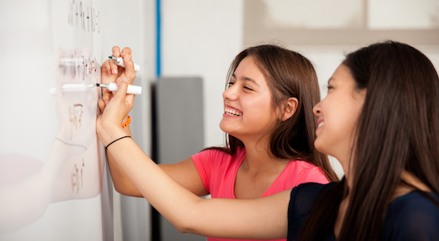
Problem Solving Session
The remainder of today’s class will comprise the problem solving session (PSS).
Your instructor will divide you into teams of 3 or 4 students.
Each team will work together to solve the following problems over the course of 20-30 minutes.
You may work on paper, a white board, or digitally as determined by your instructor.
You will submit your solution by pushing it to GitHub before the end of class.
Your instructor will go over the solution before the end of class.
Class participation is a significant part of your grade (20%). This includes in class activities and the problem solving session.
Your Course Assistants will grade your participation by verifying that you pushed your solutions before the end of the class period each day.

Slide 2

Problem Solving Team Members
Team Member Name | Check if did not do anything
Record the name of each of your problem solving team members here.
Do not forget to add every team member’s name! Your instructor (or course assistant) may or may not use this to determine whether or not you participated in the problem solving session.

Slide 3
Problem Solving 3
def build_words(word_list):
You can determine if two strings contain the same characters by sorting the strings and comparing them. For example "ate", "eat", and "tea" all sort to "aet".
Write a function that, given a list of words, builds a dictionary where each key is the sorted word and each value is a list of words that contain those letters.
For example, given the the following list of words:
["ate", "eat", "loot", "tea", "tool"]
Your dictionary should contain the following key/value pairs:
{ "aet" : ["ate", "eat", "tea"],
"loot" : ["loot", "tool"] }

